Slide 1
M365 Overview
Natasha Kempton
Sr. Programmer Analyst, DIT
nkempton@navajo-nsn.gov

Slide 2
DIT projects
For Navajo-nsn.gov Emails:
Cloud Mailboxes
M365
Email Encryption
Multifactor Authentication

Slide 3
Upcoming Trainings/workshops:
Staff and Development
DIT Workshop

Slide 4
If you are coming to our workshop:
This isn’t a presentation or a training.
It is a in-person “tutoring” or helpdesk.
Come prepared with questions. Not “I need help with everything.”
Bring your devices
We are not professional trainers, but we are willing to help.
Please be patient and kind as we are to our users. ☺

Slide 5
What is the cloud?
The cloud is like a virtual storage space.
You can access your files from anywhere with an internet connect.
You don't have to worry about your device getting lost or damage.

Slide 6
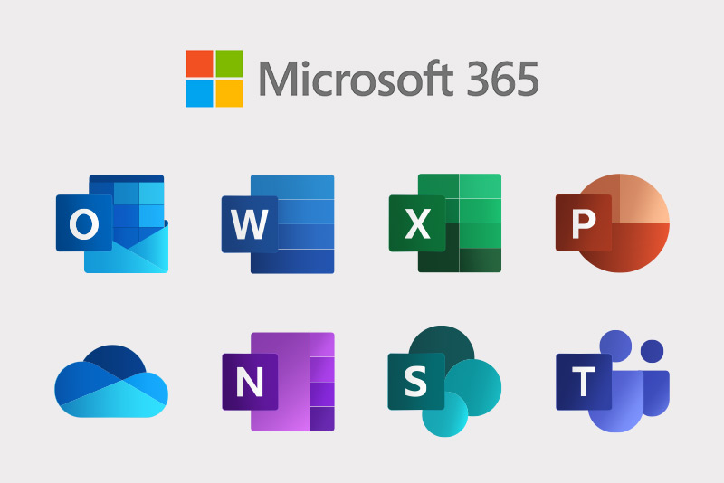
What is Microsoft 365 (M365)?
You get the basic tools you are used to (Word, Excel, and PowerPoint), that you install on your computer but with M365, you get extra goodies.
It is for collaboration purposes. Now multiple people can work with one document at the same time. Instead of sending emails back and forth.
You can even use some of the applications from anywhere with internet access without having the applications physically installed on your computer.

Slide 7
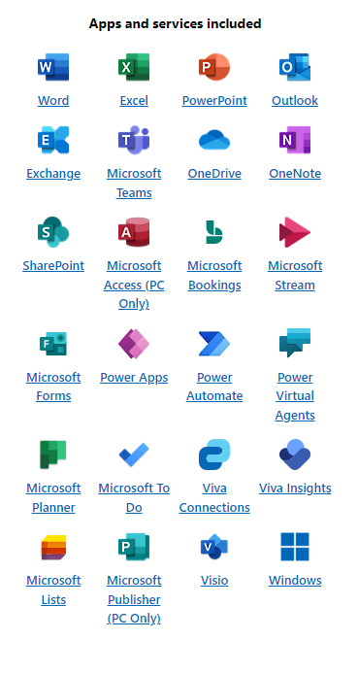
M365 Government G3
DIT has the G3 plan for M365. We are potentially moving to G5 in the future.
Link: Compare Office 365 Government Plans: Microsoft 365

Slide 8
M365 Through Your Web Browser
You will need to go to office.com
Keep in mind these browser applications are for quick edits due to the applications being compacted.

Slide 9
Multifactor Authentication and signing in

Slide 10
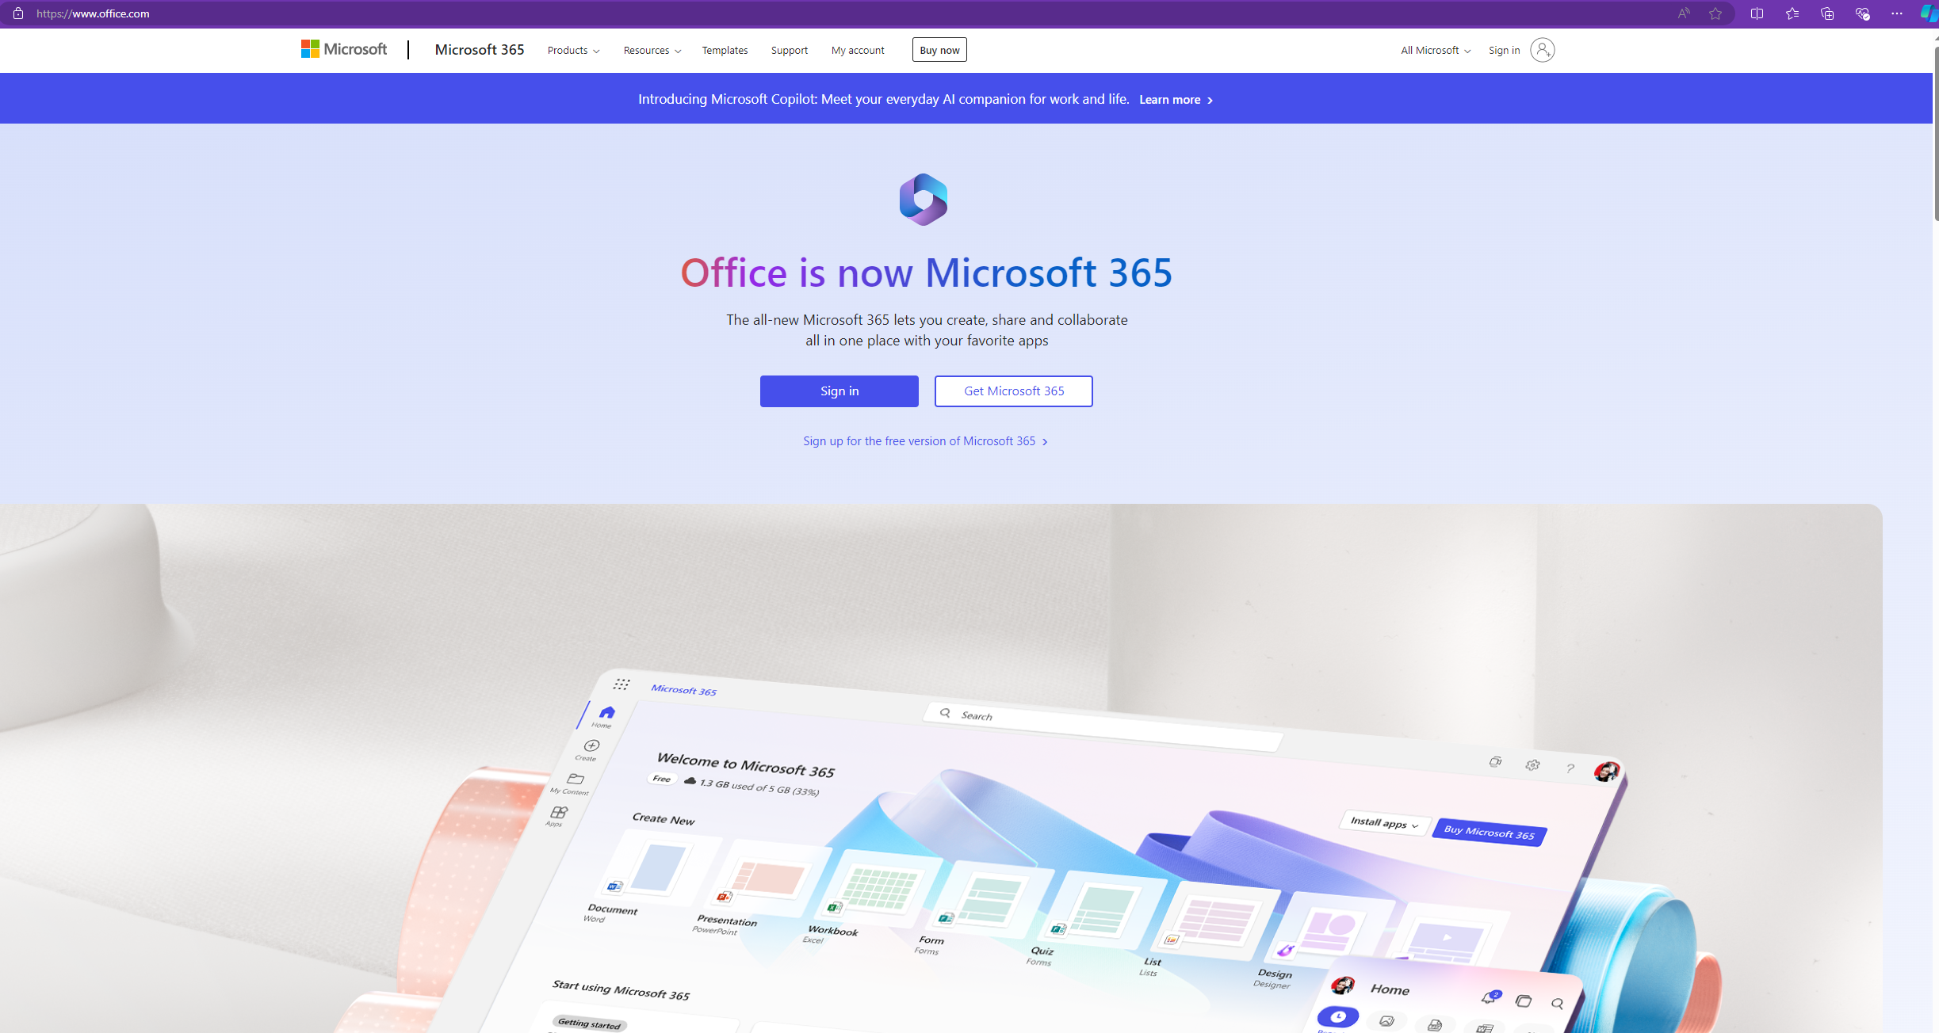
Signing in
Users will now go to office.com to activate their licenses to start using Microsoft apps.
After that, users can download the desktop applications.

Slide 11
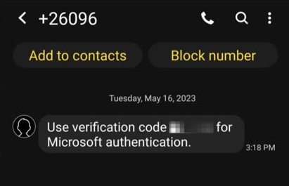
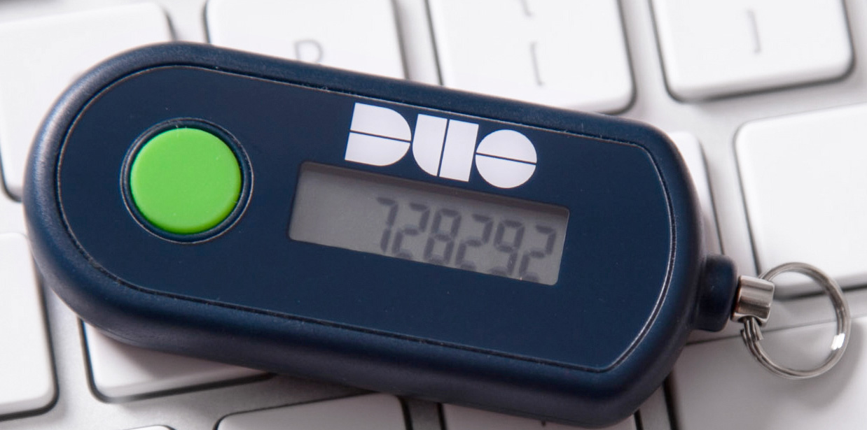
Multifactor Authentication
Some department has sensitive data, how do they protect their data?
Since our files can be taken anywhere, we need to have it protected.
DIT has 3 methods: Microsoft Authenticator App, SMS, and *limited* DUO Hardware Token.

Slide 12
MFA Process

Slide 13
SMS Process

Slide 14
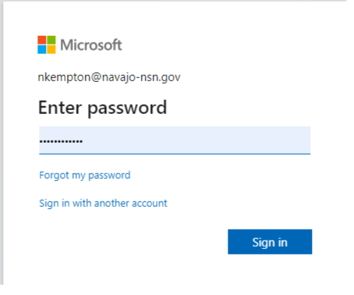
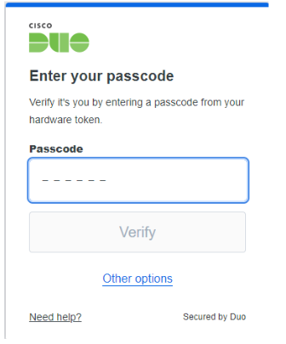
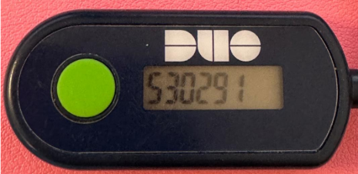
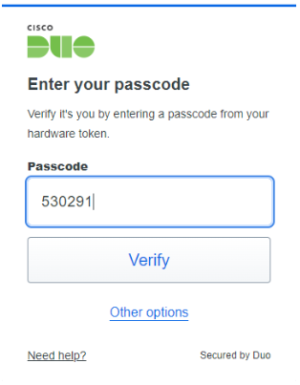
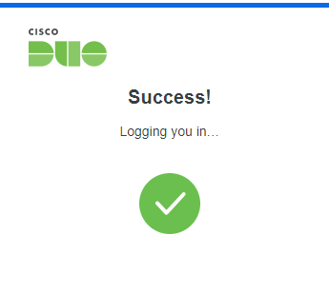
DUO Hardware Token
1
2
3
4
5

Slide 15
Having issues?
Lost your phone? Got a new phone?
Use our Help desk ticketing system and ask for a MFA reset.
Call our Help desk at 928-871-6554 and ask for a MFA reset.
After the reset you may log into office.com to reregister your MFA.

Slide 16
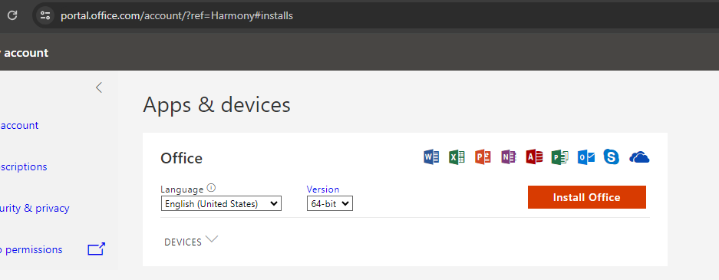
Download M365
You will need to uninstall previous Microsoft applications.
After logging in office.com, there is a button “install and more” and click install M365 apps
You will be brought to another portal, and you can select install office.

Slide 17
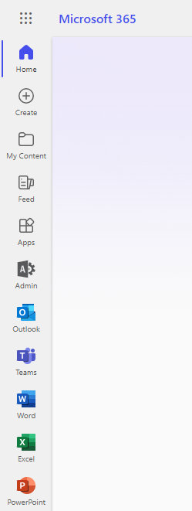
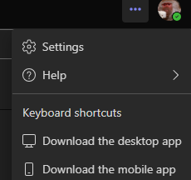
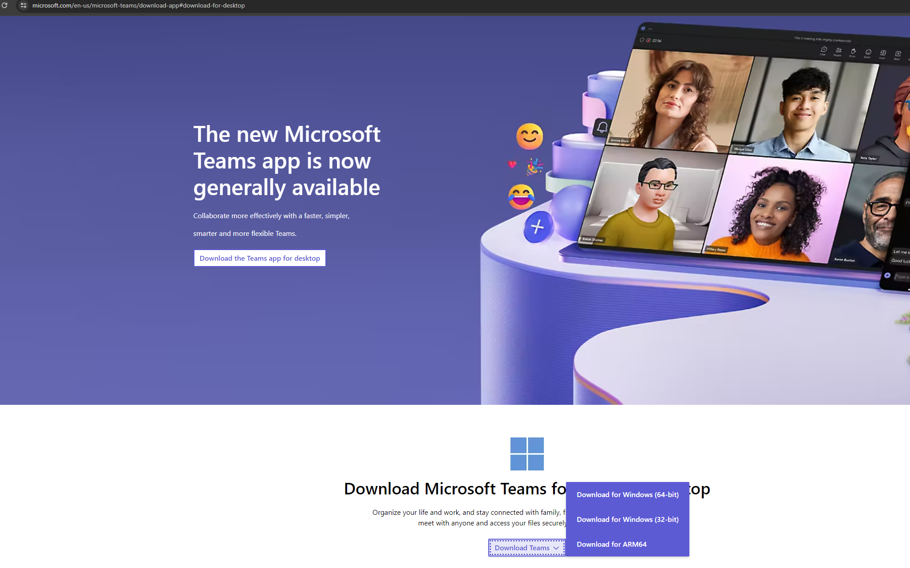
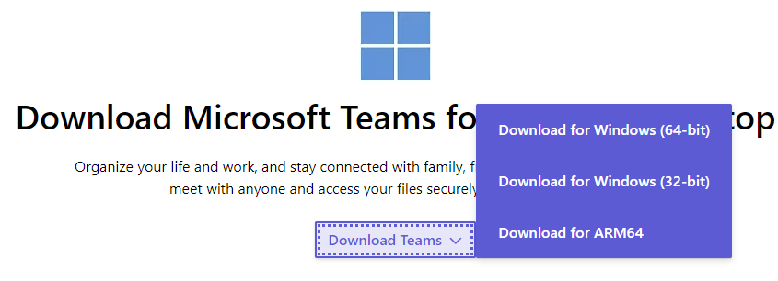
Download TEAMS
Open teams in the office.com portal.
Click the three dots, then download the desktop app
You will be taken to another portal.
You will be taken to another portal. Download “64-bit”

Slide 18
Migrating mailboxes

Slide 19
Mailbox Migration
Users will no longer be using webmail, they will be using outlook via office.com
DIT is moving Mailboxes to the cloud.
Not a massive change to the point it should be an issue.
Benefits include:
Smooth email transition
More features
Cleaner look

Slide 20
Encrypting Emails

Slide 21
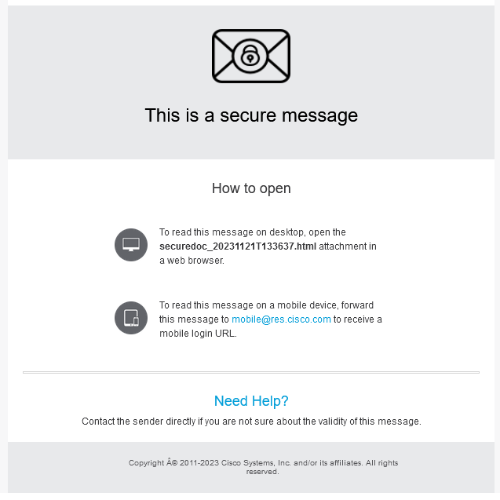
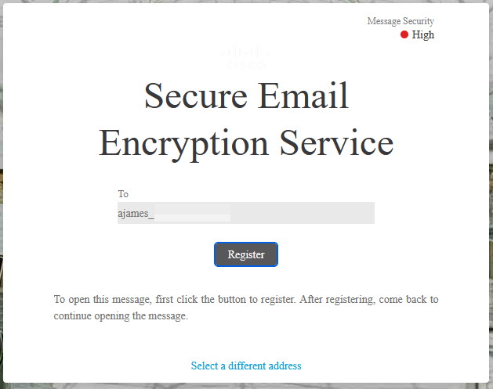
How to Encrypt emails externally
Use *encrypt* in subject line to encrypt an email.
External person would have to register to cisco
Then person receiving:

Slide 22
Security Tips
Do your “Knowbe4” training. 1–2 minute trainings.
1. Use strong, unique passwords: Avoid using common passwords and consider using a password manager to generate and store complex passwords for your email accounts. 2. Enable MFA: Add an extra layer of security to your email account by enabling 2FA, which typically requires you to enter a code sent to your phone or generated by an app in addition to your password. 3. Be cautious of suspicious emails: Avoid clicking on links or downloading attachments from unknown or suspicious emails, as they could contain malware or phishing attempts. 4. Keep your software up to date: Ensure that your applications and operating systems are regularly updated with the latest security patches to protect against vulnerabilities. 5. Encrypt sensitive emails: If you're sending sensitive information via email, consider using encryption tools or secure email services to protect your data from unauthorized access.

Slide 23
Teams

Slide 24
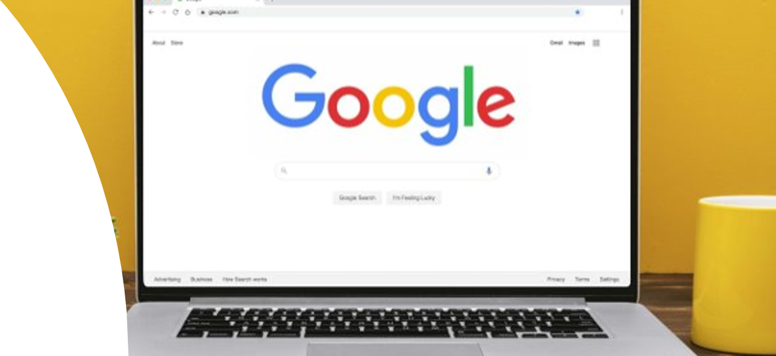
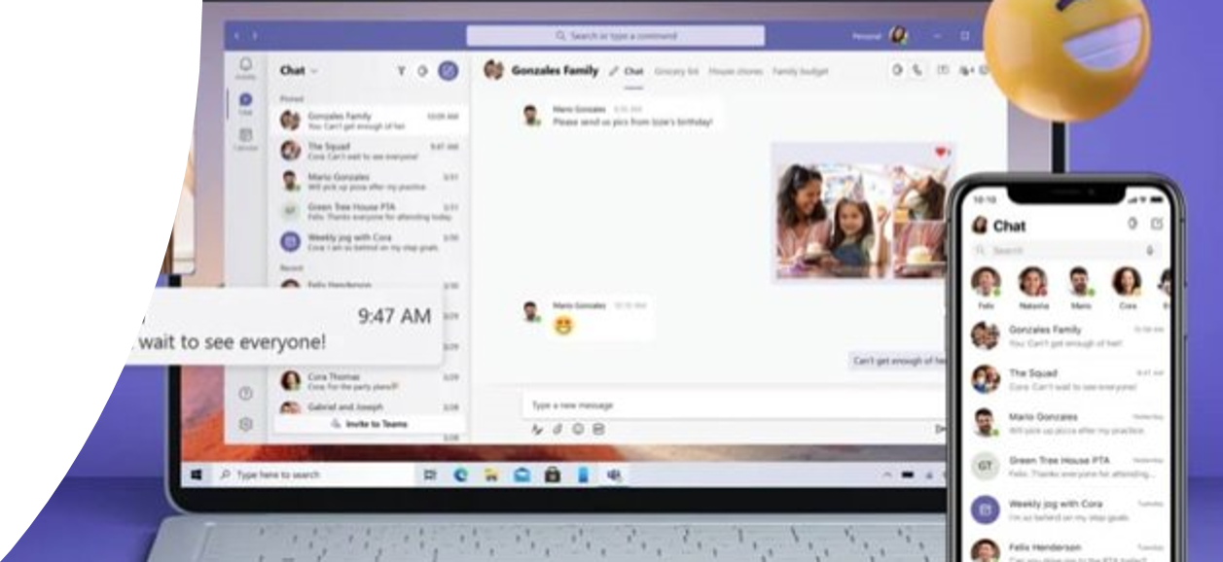
Access to Teams
You can access teams through: ​​
Web Portal – Office.com​​
The desktop app​​
Phone/Tablet app

Slide 25
Team
Team: collections of people, content, and tools surrounding different projects and outcomes within an organization. Teams can be created to be private to only invited users.​
Teams can also be created to be public and open and anyone within the organization can join (up to 10,000 members).​
Files that you share in a channel (on the Files tab) are stored in SharePoint.

Slide 26
Channel
Channels: dedicated sections within a team to keep conversations organized by specific topics, projects, disciplines—whatever works for your team.​
Channels are places where conversations happen and where the work gets done. Channels can be open to all team members (standard channels), selected team members (private channels), or selected people both inside and outside the team (shared channels).

Slide 27
Environment of Teams Example

Slide 28
Teams and Channels Video

Slide 29
Team Members
There are two main roles in Teams:​
Team owner - The person who creates the team. Team owners can make any member of their team a co-owner when they invite them to the team or at any point after they've joined the team. Having multiple team owners lets you share the responsibilities of managing settings and membership, including invitations.​
Team members - The people who the owners invite to join their team.

Slide 30
Structure Teams for your Department’s needs
You could have one general team for your department. ​​
or​​
Teams can be separated by sections (Admin, IT, etc.). ​​
Teams is a two-tier system. ​​
You could only have 30 private channels and 200 public channels. Even if you delete/restore.

Slide 31
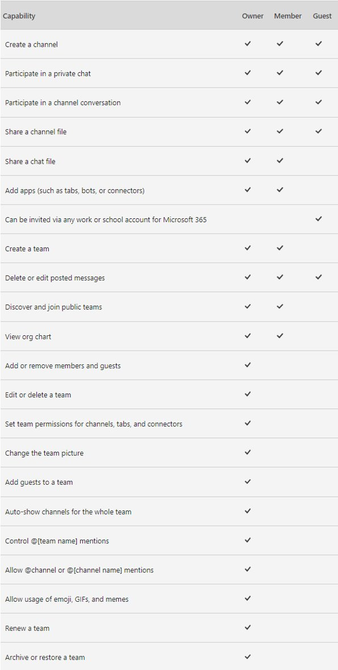
Team Owner Vs. Team Member

Slide 32
Setting up meetings in teams - how many people can be in Teams meeting? Is there a cut off time?
There is a 1,000 people limit for teams’ meetings.
If you are recording, there is a cut time of 4 hours.
Link: https://learn.microsoft.com/en-us/microsoftteams/limits-specifications-teams

Slide 33
How to set up a meeting in Teams, one-to-one; one-to-multiple
There are two ways to set up a meeting through Teams.
Teams App
Email

Slide 34
Teams App – Create Meeting
In the Teams App, select “calendar” then “new meeting.”

Slide 35
Teams App – Create Meeting
This will bring you to a new screen, You will fill out the information here, click send and meeting invites will be automatically sent.

Slide 36
Outlook App – Create Meetings
In the Outlook App, select “calendar” then “new event.”

Slide 37
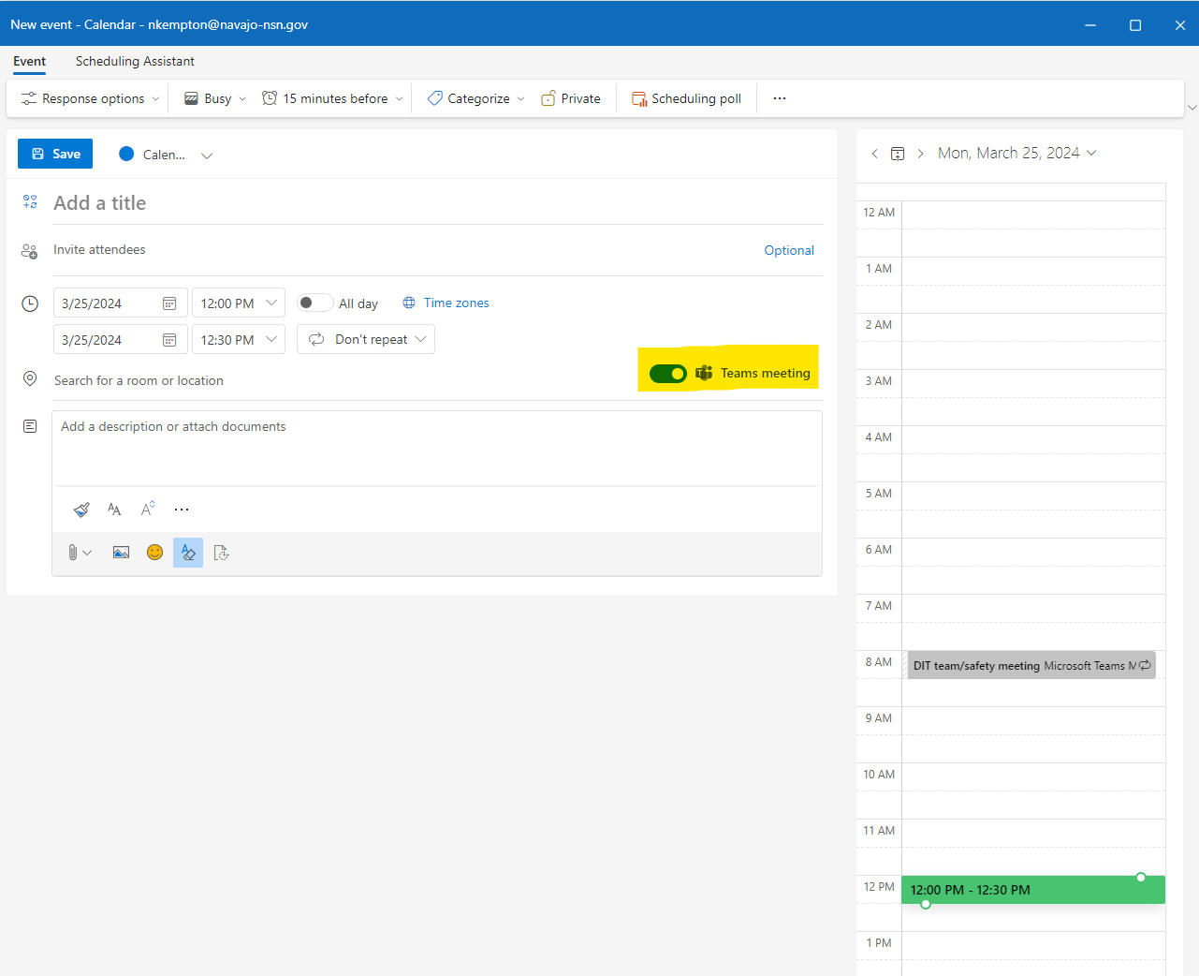
Outlook App – Create Meetings
This will bring you to a new screen, You will fill out the information here, click send and “Teams meeting” meeting invites will be automatically sent.

Slide 38
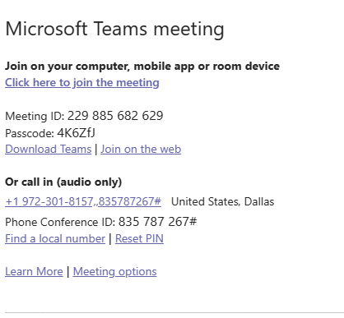
Meeting invite

Slide 39
OneDrive

Slide 40
Introducing onedrive

Slide 41
How to share documents with others, locked and unlocked documents
As you work in Microsoft 365, it's simple to share your documents.
Select Share and then select Link settings.
Choose the permissions you want, choose if you want to Allow editing, and then select Apply.
Type the names or email addresses you want to share with, add an optional message, and select Send.

Slide 42
How to share documents with others, locked and unlocked documents
After you've shared a document, the document and its metadata will show up automatically in the recipient's Shared view in OneDrive, Word, Excel, PowerPoint, and Office.com experiences. Go to See files others have shared with you to learn more.
The act of sharing maybe successful, however, the recipient may not be able to open the file because of the Sensitivity label on it.

Slide 43
Can we share documents in .pdf or just Word/Excel/PPT? can we share with others outside our tenant?
You can share all documents.
External sharing:
You can share your files outside our organization. It will also ask the person you’re sending the file to verify their identity.

Slide 44
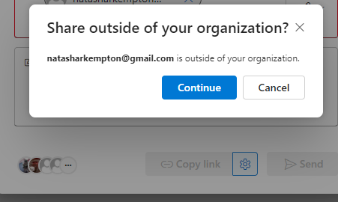
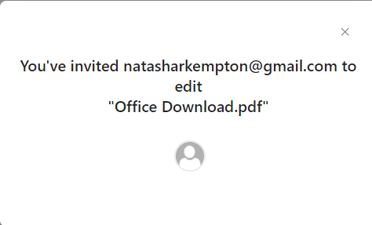
The process of external sharing through one drive

Slide 45
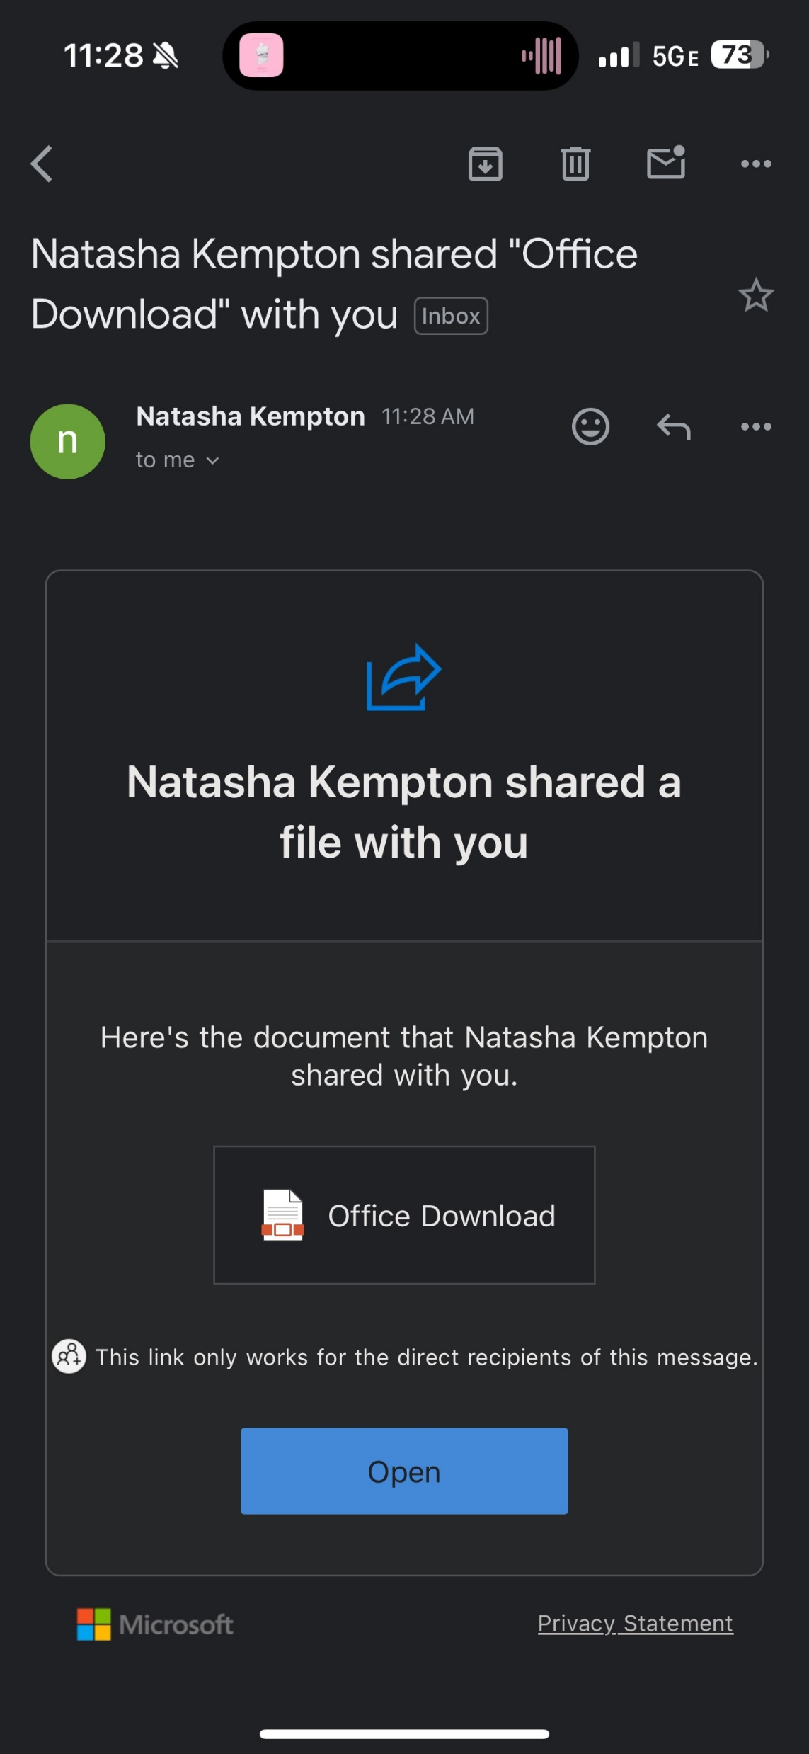
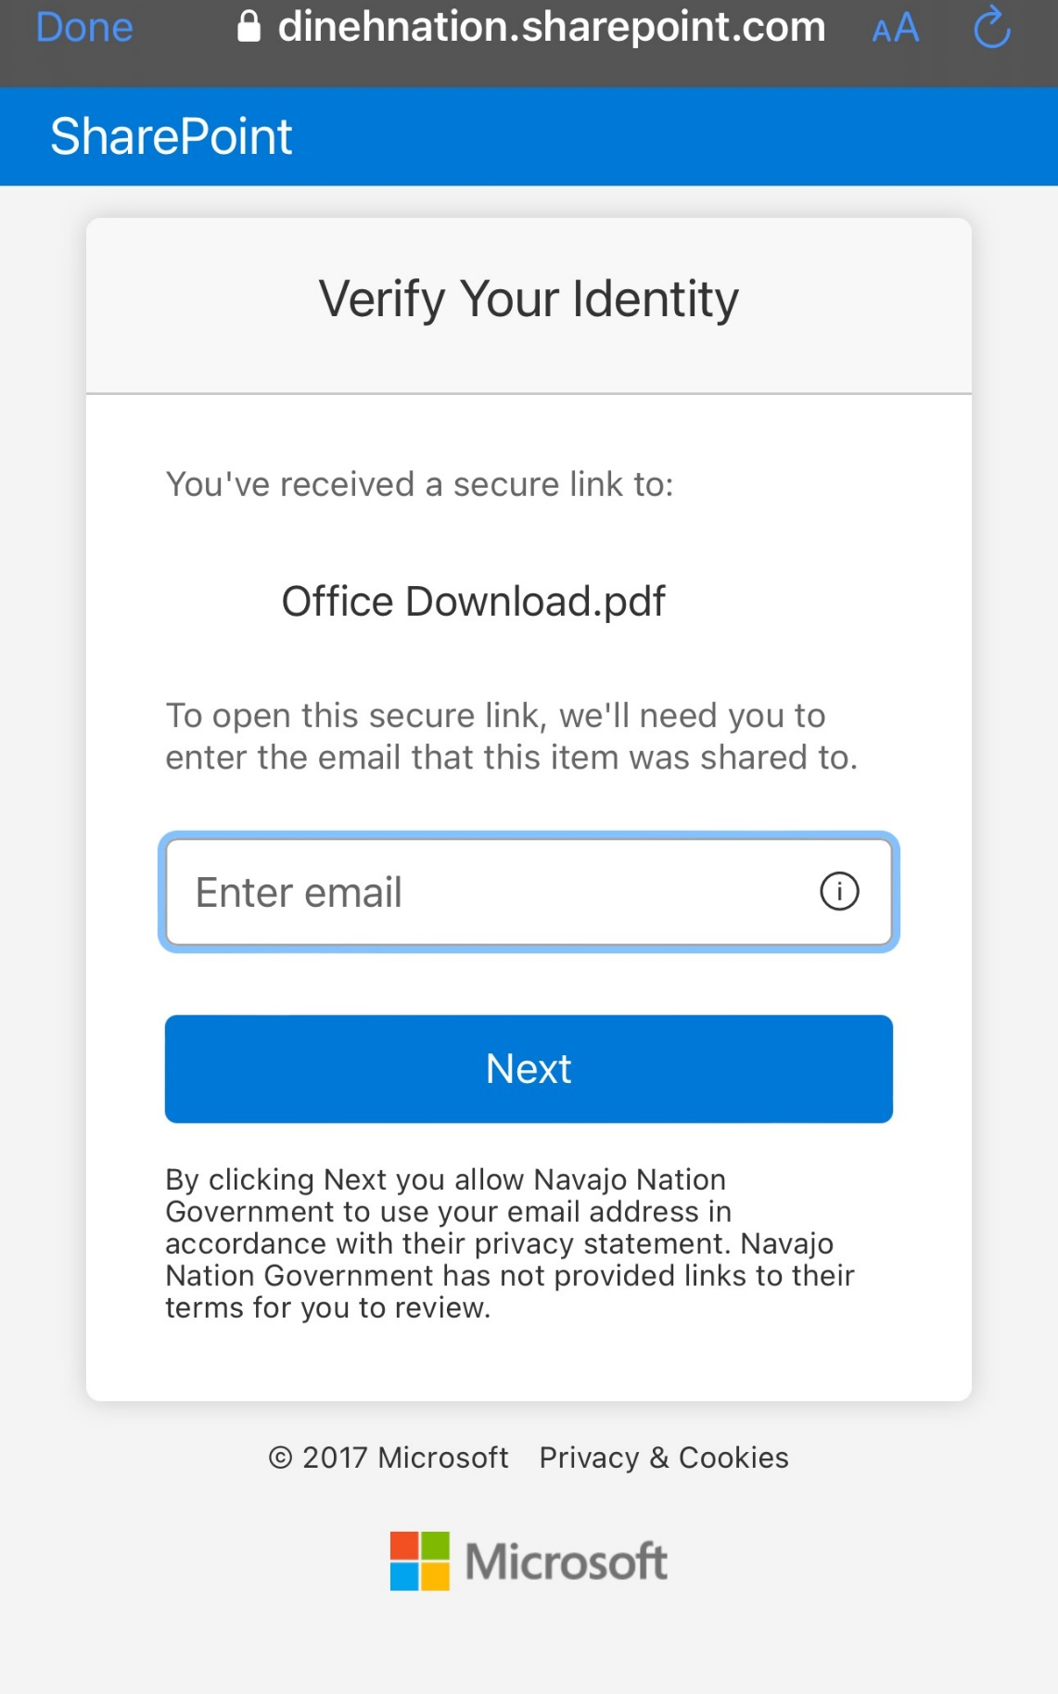
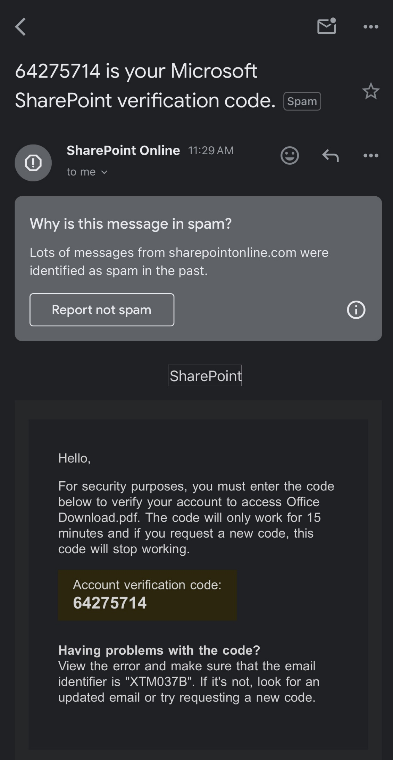
The process of external sharing through one drive
The external user’s side:

Slide 46
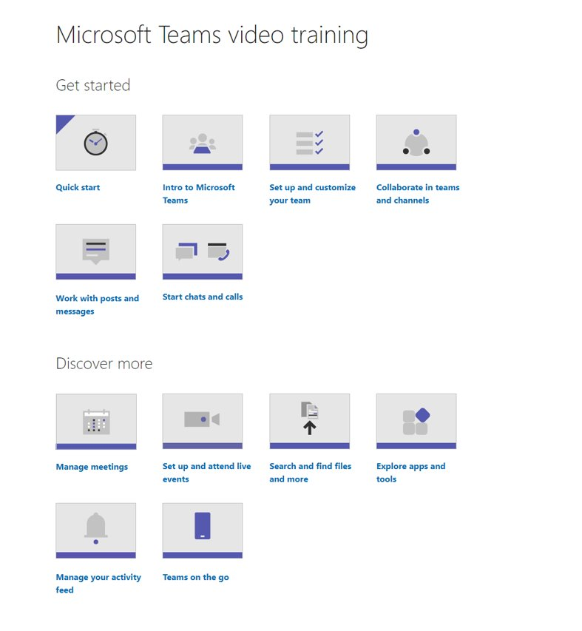
End User Support:
Microsoft Teams video training - Microsoft Support
https://learn.microsoft.com/en-us/microsoftteams/teams-overview
DIT Helpdesk: 928-871-6554

Slide 47
Thank you!! ☺

